Slide 1

Artificial Intelligence for Business Decisions and Transformation
CSCN8030 - Spring 2024 - Section 2
Final Presentation
August 12, 2024
Group 4 - Members:
Krishna Kumar, Hemasree
Shijin, Jency
Fernandez, Arcadio
Professor:
Glaucia Melo dos Santos, PhD

Slide 2
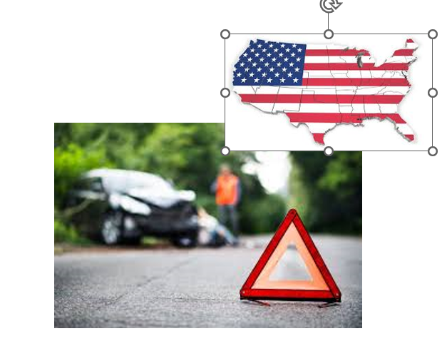
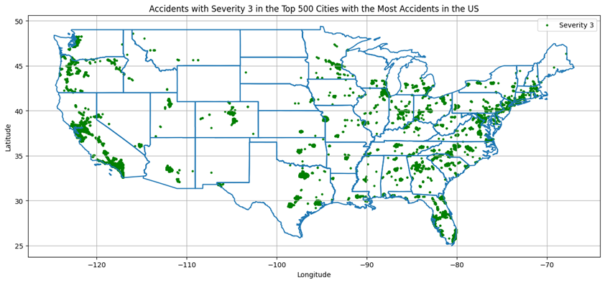
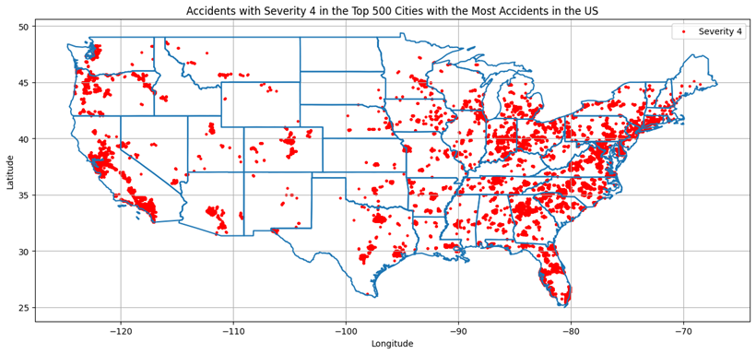
Sprint 1
What have we learned?
The project underscored the broader societal implications of traffic accident modeling, emphasizing the need for preventive strategies to reduce fatalities and economic costs associated with accidents. The use of AI models like random forests demonstrated their potential to enhance predictive accuracy compared to traditional methods, showcasing AI's transformative role in business decision-making. It also revealed how external factors, such as state laws and driving behaviors, significantly influence insurance premium costs.
Project Overview
US Traffic Accident Severity Prediction (2016-2023) aims to model and predict traffic accident severity across the United States. In 2021, there were 39,508 fatal crashes resulting in 42,939 deaths in the U.S. The fatality rate varies significantly by state, highlighting the need for effective predictive modeling. Dataset includes approximately 7.7 million accident records from 49 states, collected from various traffic data sources.
Insights to the Business
Statistical analysis identified trends and correlations in accident occurrences.
Insights can help businesses and policymakers in the transportation sector to make informed decisions, improve safety measures, and potentially reduce the economic costs associated with traffic accidents, which are estimated at $340 billion annually by the U.S. Department of Transportation
In 2022, property and casualty insurance premiums reached $715.9 billion in the U.S.
Variations in car insurance premiums across states are influenced by laws, uninsured driver rates, and economic factors.

Slide 3

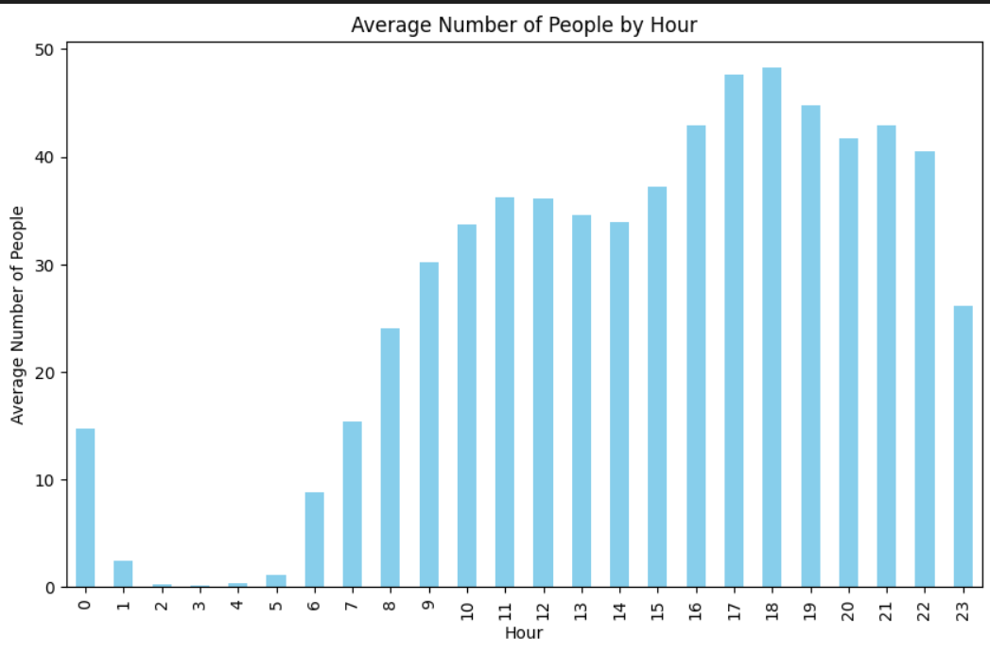
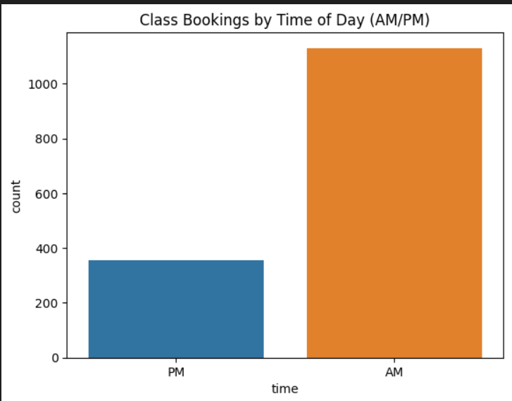
Sprint 6
What have we learned?
From this project, We discovered that SVM is particularly effective at predicting class attendance, whereas Decision Trees are better for forecasting gym equipment usage. Employing feature importance analysis, grid search, and cross-validation was instrumental in refining model performance and selecting the best hyperparameters. Ultimately, using these predictions for dynamic resource management facilitates more efficient scheduling and equipment allocation, resulting in enhanced operational efficiency and greater member satisfaction.
Project Overview
The project aims to optimize the use of fitness classes and gym equipment at GoodLife Fitness through predictive modeling and optimization strategies. The goal is to forecast member attendance to adjust class availability dynamically, enhancing attendance and satisfaction and to predict crowd levels using historical data, additional factors like weather and holidays, allowing for better crowd management and facility usage.
Insights to the Business
By scheduling more classes in the morning, GoodLife can ensure higher attendance rates and better resource utilization.
Accurate forecasts of gym occupancy can help manage crowd levels, providing a more comfortable environment for members and potentially increasing member retention.
These insights can inform strategic decisions regarding staffing, marketing, and facility management, aligning them with member needs and preferences.
By understanding patterns in gym usage, GoodLife can optimize staffing and maintenance schedules, reducing costs and improving service quality.

Slide 4

Career Advancement Plan as a Data Scientist
Hemasree Krishna Kumar
Pursue Co-op Opportunities:
Apply for co-op positions to gain practical experience and apply theoretical knowledge in a real-world setting.
Upgrade Skills:
Tableau & Power BI: Develop expertise in data visualization and reporting.
AWS Cloud: Enhance skills in cloud computing for managing and scaling data solutions.
Focus on MLOps:
Learn MLOps to optimize and automate the deployment and management of machine learning models.
Acquire Docker Skills:
Master Docker to improve containerization, ensuring consistent and portable deployment of applications.
Build a Portfolio:
Develop a portfolio that highlights your projects, skills, and accomplishments, including work with tools like Tableau, Power BI, AWS, and Docker, as well as MLOps practices.

Slide 5

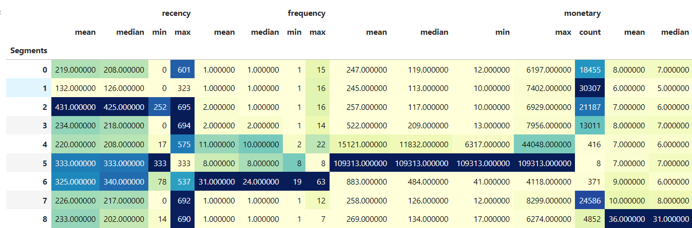
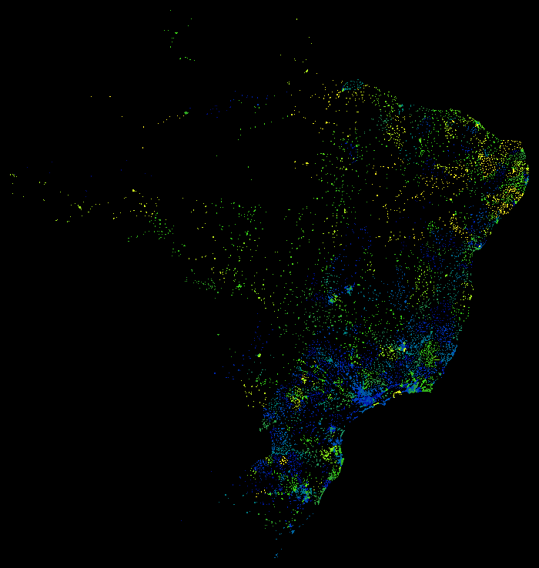
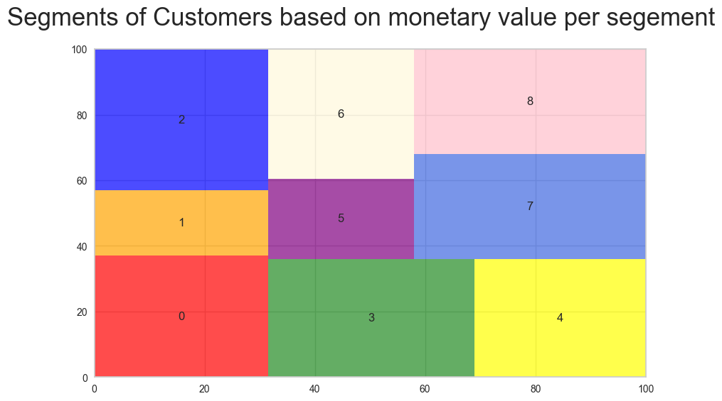
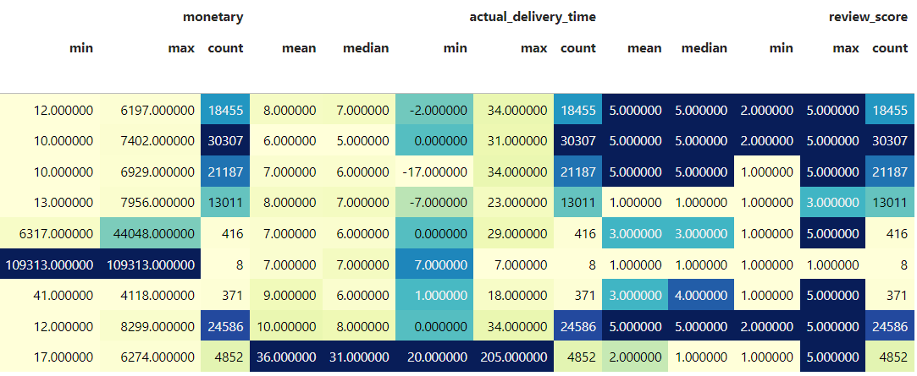
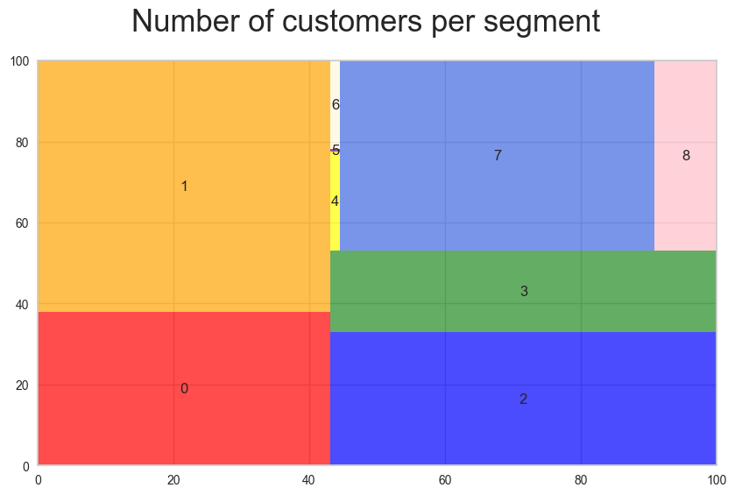
Sprint 2
What we learned?
This project offers a practical application of data analysis and machine learning techniques in a real-world context. By working with a rich dataset from the Brazilian eCommerce industry, we gained hands-on experience in customer segmentation, a crucial aspect of marketing and business strategy. Also, businesses can uncover actionable insights that drive marketing campaigns, optimize inventory management, and enhance customer experiences.
Project Overview
This is a Brazilian e-commerce public dataset of orders made at Olist Store. The dataset has information on 100k orders from 2016 to 2018 made at multiple marketplaces in Brazil. Its features allow customers to view orders from multiple dimensions: from order status, price, payment, and freight performance to customer location, product attributes, and, finally, customer reviews.
Insights to the Business
Performing KMeans clustering
What is the Average Ticket?

Slide 6

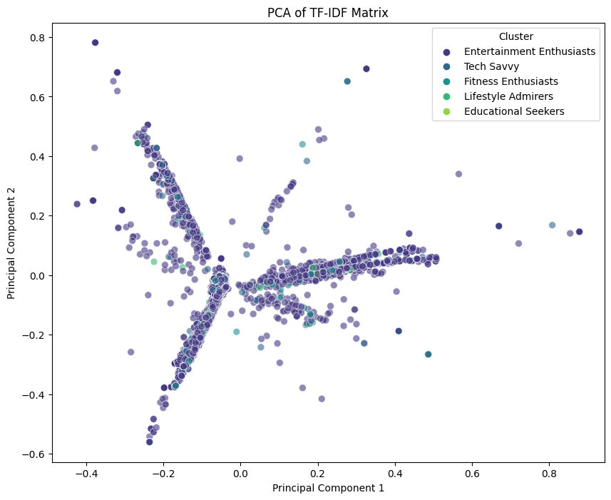
Sprint 5
What we learned?
Project Overview
In this project, we developed an AI system to automatically classify user interest profiles from TikTok reviews using supervised learning and sentiment analysis. This can help businesses understand user preferences, enhance content recommendations, and assist influencers in refining their content strategies.
This project aims to develop a comprehensive system to profile TikTok users based on their app review texts. By analyzing the textual content of user reviews, we intend to categorize users into specific interest groups such as Entertainment Enthusiasts, Educational Seekers, Lifestyle Admirers, and more.
Insights to the Business
Predictions on a subset of the data and display some reviews with their predicted categories:
Review: Its addicting and i love it alot
Predicted Interest Category: Entertainment Enthusiasts
Review: Widked app, cant fault anything with it. Just need to spend some time to get around with all filters ect... but its a fun app for everyone!
Predicted Interest Category: Entertainment Enthusiasts
Review: I love this app it is really fun to do
Predicted Interest Category: Fitness Enthusiasts
Review: Helps me with stress
Predicted Interest Category: Entertainment Enthusiasts
Review: Its good but the app likeis better
Predicted Interest Category: Entertainment Enthusiasts

Slide 7
Each student should also add a reflection on how they plan to take their career as Data Scientists forward.
Arcadio Fernandez
“10 000 hour rule”
Become an entrepreneur
Open my tech enterprise with great partners
Find a Co-op
Asserting that the key to achieving true expertise in any skill is simply a matter of practicing
How can I implement AI and ML in my business?
AI will not replace you, but the person using AI will
Co-operative
Education will give me a deeper, richer educational experience, real-world work experience, career connections and employment income during work terms.
I want to become a reference as a bridge between the traditional industry and the tech industry
Learning
Linux, RL etc
Revisiting some concepts:
SQL, docker
Industry 4.0

Slide 8

Sprint 3
What we learned?
Project Overview
Crop Yield Prediction project uses advanced machine learning techniques to accurately forecast crop yields, revealing key insights into environmental factors and agricultural productivity. KNN, Random Forest, and Bagging Regressor emerged as top models with high R² scores and low MSE values. This project not only enhances our data analysis skills and domain-specific knowledge but also positions us at the forefront of leveraging AI to drive sustainable agricultural practices.
The Crop Yield Prediction project aims to forecast the yield of various crops based on environmental and agricultural factors. This project is vital for agricultural planning, resource allocation, and food security. Accurate predictions assist farmers and policymakers in making informed decisions about crop management, irrigation, and pest control strategies.
Insights to the Business
Precision Agriculture:
Optimized Resource Management: By leveraging predictive models, farmers can optimize irrigation and fertilizer use, leading to water savings and efficient fertilizer planning.
Climate-Specific Crop Recommendations: Recommendations for crops that are likely to thrive under current and forecasted climatic conditions, ensuring better crop management and yield.
Investment Decisions:
High Yield Areas: Focus investments on areas and crops predicted to have the highest yields This strategic investment can lead to higher returns and more efficient resource allocation.
Sustainable Practices:
Environmental Benefits: Reduce the overuse of water and fertilizers. This contributes to sustainable farming and long-term agricultural productivity.
Food Security: Accurate crop yield predictions help ensure food security by enabling farmers to grow crops more efficiently and sustainably, ultimately boosting farm productivity and meeting global food demands.

Slide 9
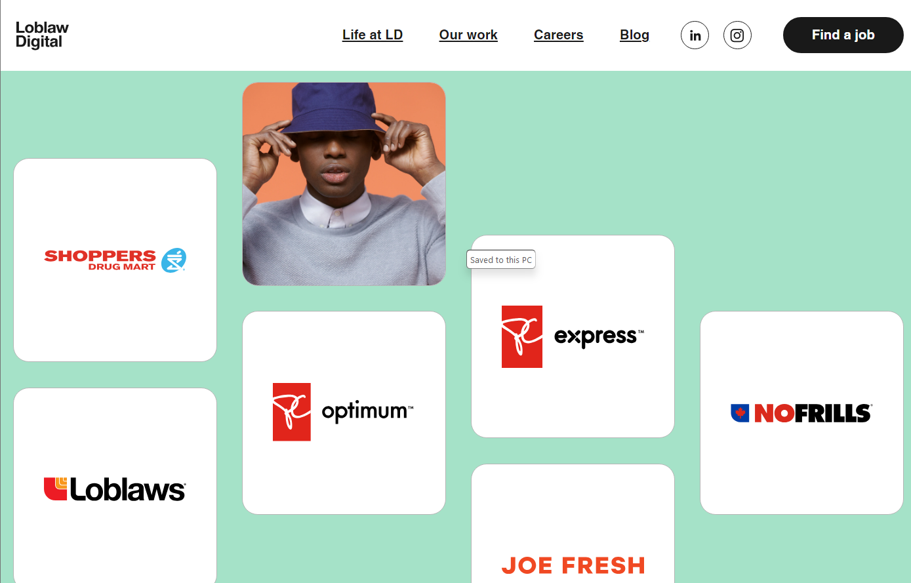
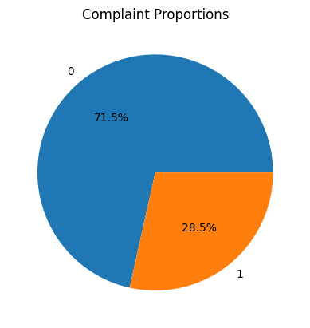
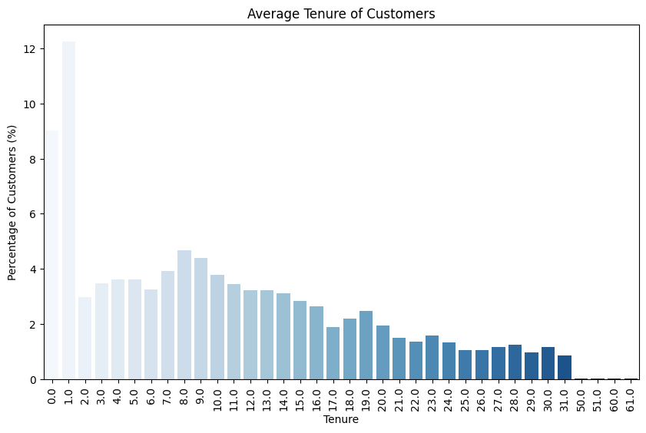
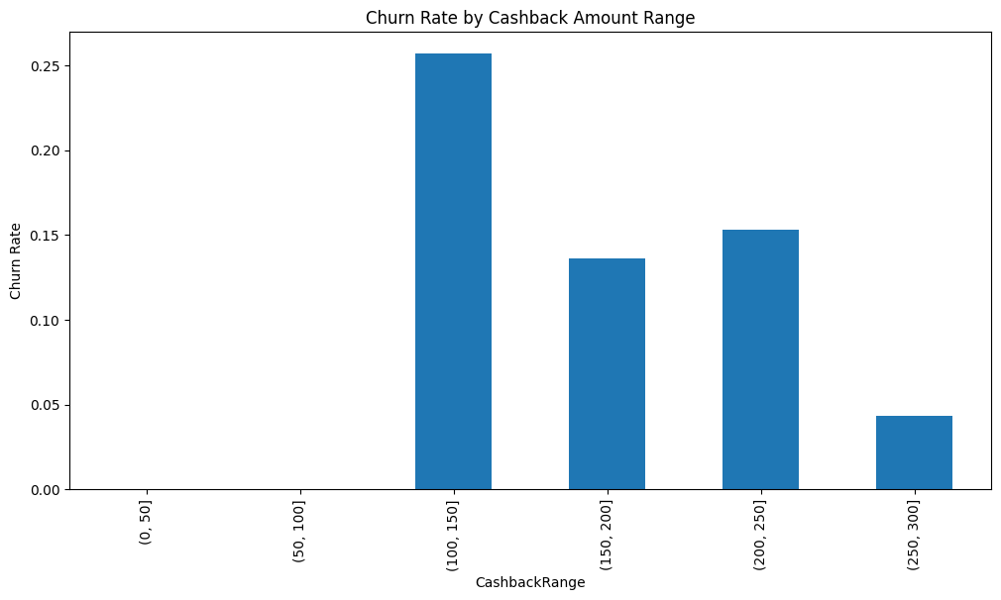
Sprint 4
What we learned?
Project Overview
Theis project uses advanced machine learning techniques to identify customers at risk of attrition. By leveraging features like complaints, tenure, marital status, preferred order categories, and cashback amounts, we gained key insights into customer behavior and churn factors. Random Forest emerged as the top model with the highest accuracy. This project allowed us to apply theoretical knowledge to a real-world problem, enhancing our problem-solving skills and strategic decision-making abilities.
This project aims to develop a comprehensive system to predict customer attrition for Loblaws Digital using various customer-related variables. By analyzing the attributes and behaviors of customers, we intend to identify those at risk of leaving and develop targeted retention strategies to enhance customer loyalty and reduce churn rates.
Insights to the Business
Retention Strategies :
Address Complaints: Implement a robust complaint resolution system to address customer issues promptly and effectively.
Retention Programs for New Customers: Focus on retaining new customers by offering incentives and improving their overall experience.
Optimize Cashback Offers: Analyse the impact of different cashback amounts on churn and consider optimizing cashback offers to retain customers.

Slide 10
Career Advancement Plan as a Data Scientist
Jency Shijin
Business Acumen
Focus on improving my ability to communicate complex data insights into actionable business strategies for non-technical stakeholders.
Internships:
Actively looking for co-op opportunities /internships to apply my skills in real-world settings.
Continuous Learning:
Deepen machine learning expertise. Engage in hands-on projects, self-directed learning, and contribute to open-source projects to stay current and competitive.
Domain Knowledge: Develop domain knowledge by studying trends, attending seminars, and collaborating with experts to apply data science skills in specific industries like finance, healthcare, and retail.
Real-Time Analytics Expertise Leverage Kafka and Redis experience to enhance real-time analytics by exploring complex event processing and integrating machine learning. Optimize performance, scale systems, and develop industry-specific solutions to solidify expertise in this domain.

Slide 11

Thank You

